Slide 1


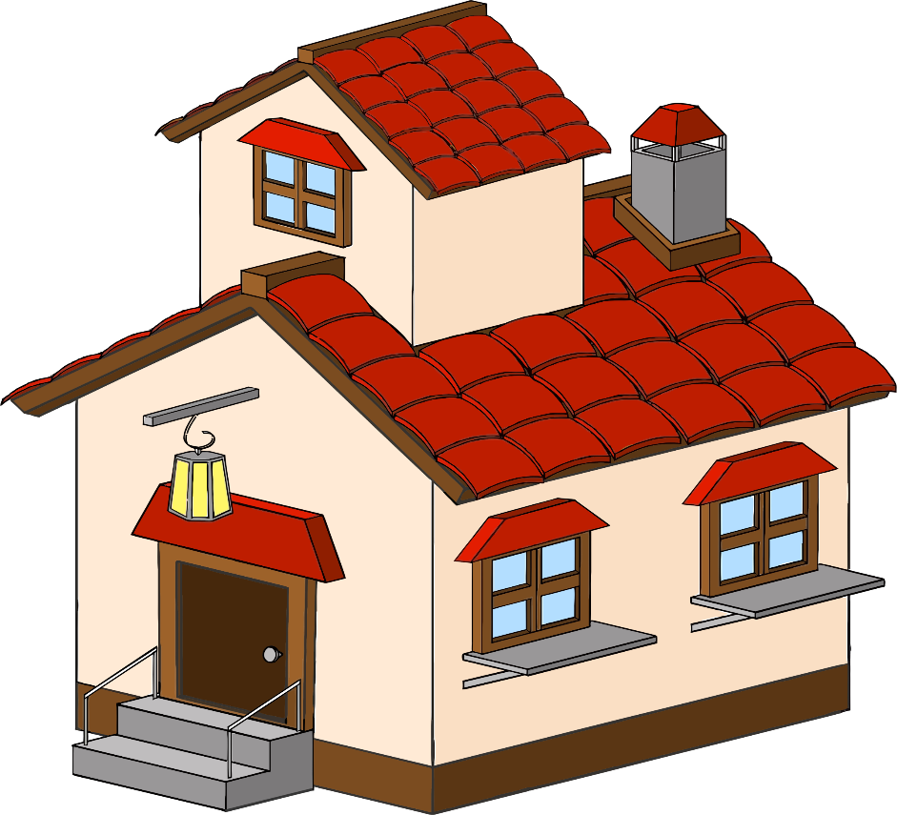
“ Imagine this: Mr. X is standing in his dream house, picturing his future there. But before he commits, he needs answers. Is this a wise investment?
Can he use it for a profit? Is he overpaying?.
Now, imagine a real estate agency that wants to provide accurate advice to their customers while also being, competitive in the market.
Welcome to a journey into the future of real estate, where innovation meets tradition and transforms the way we predict house prices.”
1

Slide 2

Real Estate Industry
Utilization of Machine Learning (ML) in prediction of House Pricing at
the Real Estate Industry
Kermina Rafik Abd El Sayed
P-EM0248/23
2

Slide 3

Real Estate Industry
Fourth industrial Revolution (I4.0)
REAL ESTATE Industry
The fourth industrial revolution transformed how economy and industries operate.
It was initiated by digital technologies advancement.
Technological Integration( AI, ML, IoT..)
It led to increasing automation, efficiency, and productivity, and encouraging data-driven decisions.
www.reallygreatsite.com
3

Slide 4

Property Technology
(Prop-tech)
Real Estate Industry
REAL ESTATE Industry
Property technology or prop-tech definition.
Prop-tech is disrupting the practices of traditional real estate market.
Artificial intelligence and machine learning as part of prop-tech.
www.reallygreatsite.com
4

Slide 5

Problem Statement
REAL ESTATE Industry
Accurate house price prediction is essential in real estate industry.
Traditional methods are time-consuming and often inaccurate.
Inaccurate predictions leads to monetary loss, wasted resources, and damage to public trust.
Proposed Solution:
Machine Learning (ML).
Training ML models on historical.
ML models predict house prices.
Benefits:
High accuracy
save cost and time
Build Trust.
Make Informed Decision.
5

Slide 6

Study Objectives
Real Estate Industry
To evaluate the performance of different advanced regression models in predicting house prices using Kaggle dataset.
To identify key preprocessing techniques that can manage missing values, outliers, and normalization for house prices prediction.
01
03
To understand different features that influence house prices prediction.
To identify the most suitable feature engineering technique to enhance models’ prediction.
02
04
To highlight possible future work and limitations.
05
6

Slide 7
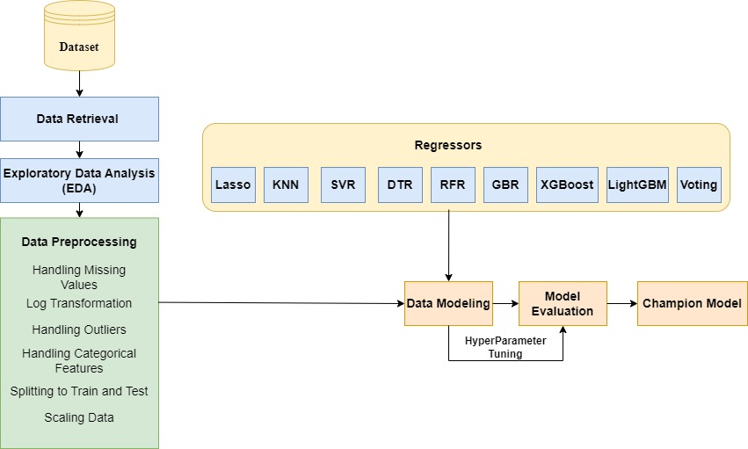
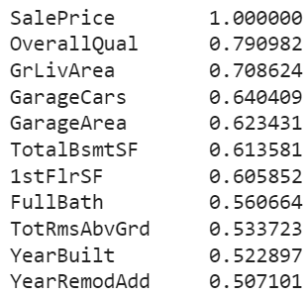
Methodology
Exploratory Data Analysis (EDA)
Importing the Data:
- Ames housing data from Kaggle.
- 1460 observations, 79 houses features and target feature.
2) Overview of Data:
- Examined Data shape, information, and column names
- Generated Summary statistics.
- checked for duplicates in the dataset.
3) Sale Price Analysis:
- Key statistics(mean > median)
- Identified a right-skewed distribution
4) Visualization:
- bar plot, pair plot and histogram plot.
5) Correlation analysis.
- heat map and Pearson correlation.
7

Slide 8
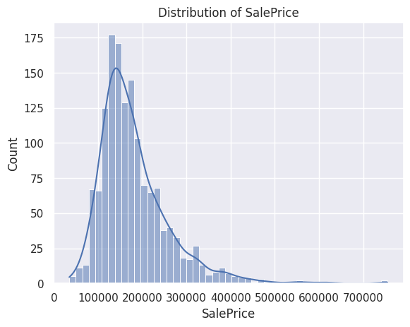
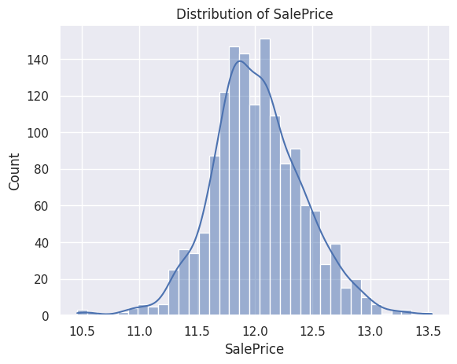
Methodology
Data Pre-Processing
1) Handling Missing Values:
- 19 features out of 79 contained null values.
- Nulls were replaced with other values according to (data type and description).
Log Transformation:
- According to Sale Price Histogram, it was right skewed and Log transformation was used to be normally distributed.
3) Handling Outliers:
- Discovered features Outliers was handled using capping method, which replace them with a value based on IQR to preserve their information instead of removing them from the data set.
4) Handling Categorical features:
- Label encoder(), to encode categorical features.
5) Splitting the data into train and test datasets.
6) Standardizing data:
- Using StandardScaler(), which is used to scale the data when the data has different value scales.
8

Slide 9

Modeling and Evaluation Techniques
Nine models were built in this study including:
- LASSO, K-nearest Neighbor Regressor (KNN), Support Vector Regressor (SVR), Decision Tree Regressor (DTR), Random Forest Regressor (RFR), Gradient Boosting Regressor (GBR), XGBoost, LightGBM ,and Voting Regressor.
Evaluation Techniques used:
- Root Mean Square Error (RMSE)
- Mean Absolute Error (MAE).
- R² Squared.
Hyperparameter tuning:
- RandomizedSearchCV() was used, it randomly selects values for each hyperparameter, effectively reducing computational costs associated with hyperparameter optimization.
9

Slide 10
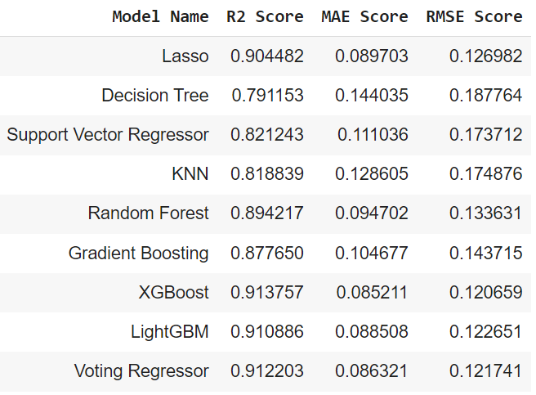
Results and Discussion
XGBoost model is the champion model:
- highest R² squared score (0.913757).
- lowest MAE score (0.085211).
- lowest RMSE score (0.120659).
Voting Regressor model is the 2nd best model:
- It combines Gradient boosting, XGBoost, and LightGBM.
-high R² squared score (0.912203).
- low MAE score (0.086321).
- low RMSE (0.121741).
Decision Tree is the worst performing model:
- lowest R² squared score (0.791153).
- highest MAE score (0.144035).
- highest RMSE score (0.187764).
XGBoost feature importance to understand top features contributed to the price predictions.
10

Slide 11

Results and Discussion
Discussion:
The XGBoost model performance results suggest that it is a powerful ensemble model.
The strong performance of other ensemble models including Voting Regressor, and LightGBM, supports that ensemble models are more suitable for house price prediction, as they combine the advantages of various models.
Results from correlation and XGBoost feature importance suggests that the most dominant factor is the house overall quality, in addition to Garage size, above ground area, Kitchen quality, and newly built home represented in (YearBuilt & YearRemodADD) features. This understanding of key factors can be valuable to home buyers and investors in the real estate industry.
11

Slide 12


Limitations and Recommendations
Limitations :
Small Data Size (lack of capturing the variability of house market trends).
Large number of subjective features.
lacks necessary features.
Consistent data structure for other predictions.
The dataset cover narrow range of years.
Recommendations:
More feature engineering.
More advanced models.
More study can be done to encourage real estate companies to use property technology.
Future website or mobile application for house price predictions. (better understand the real estate market and not to be scammed with incorrect property prices or costs.)
12

